Slide 1
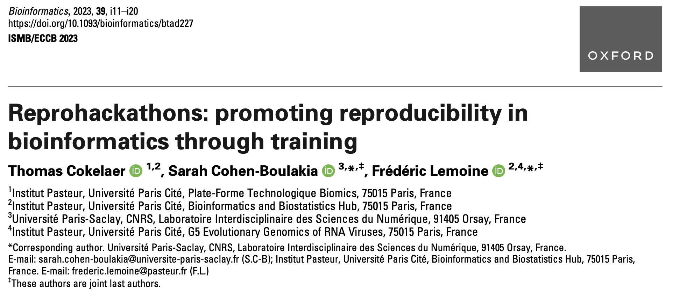
BNF8166 - Seminar in Bioinformatics
Sept. 13, 2023

Slide 2
1. Reprohackathon overview
Course structure and goals
Practices for good reproducibility
2. Reproducibility exercise results
Students’ attempts to reproduce the findings from a published study

Slide 3
Reprohackathon
MSc course offered at the Université Paris-Saclay (France)
Running for 3 years, attended by 123 students
Goals: (1) Introduce students to concepts and tools in bioinformatic reproducibility, and (2) gain practical experience in reproducing published findings while using reproducibility technologies
Part 1:
Learning about good practices in reproducibility
Learning about versioning (Git), workflows (Nextflow, Snakemake), containers (Docker, Singularity) and workflow execution
Part 2:
Practical application
Reproduce the findings of a published paper (RNA-seq to identify differentially expressed genes in uveal melanoma primary tumors)

Slide 4
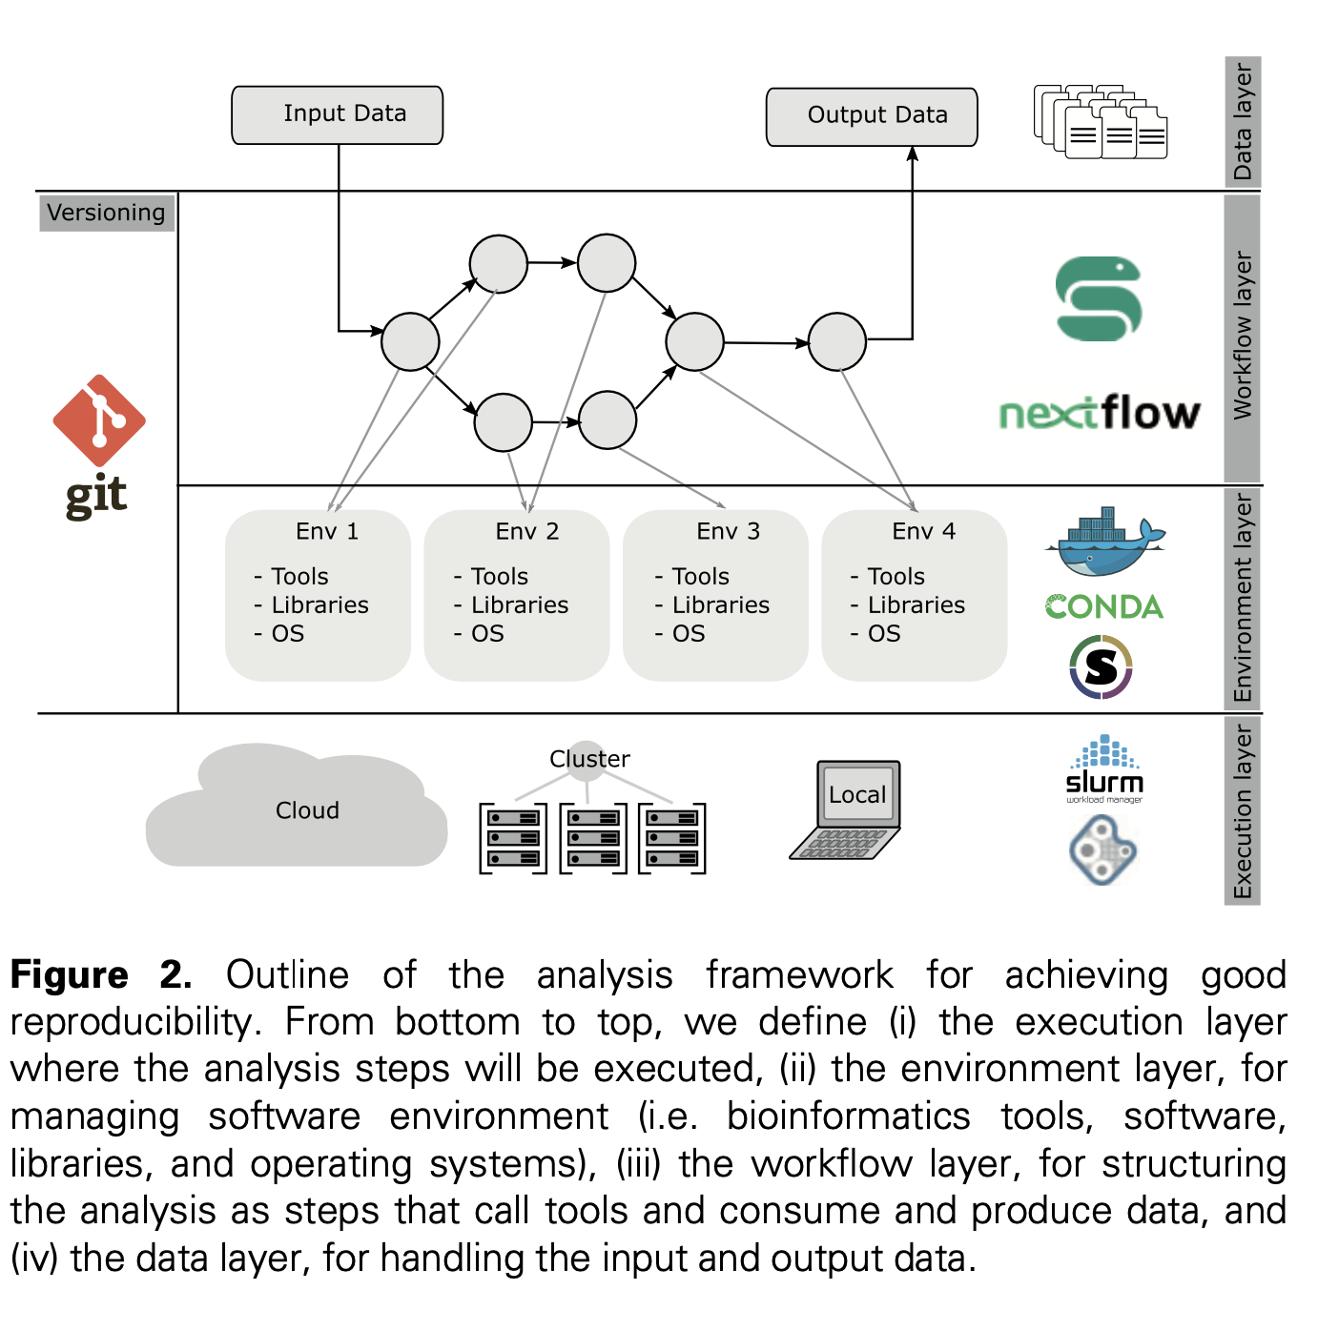

Slide 5
Bioinformatic analysis design
Data layer
Input files
Output files

Slide 6
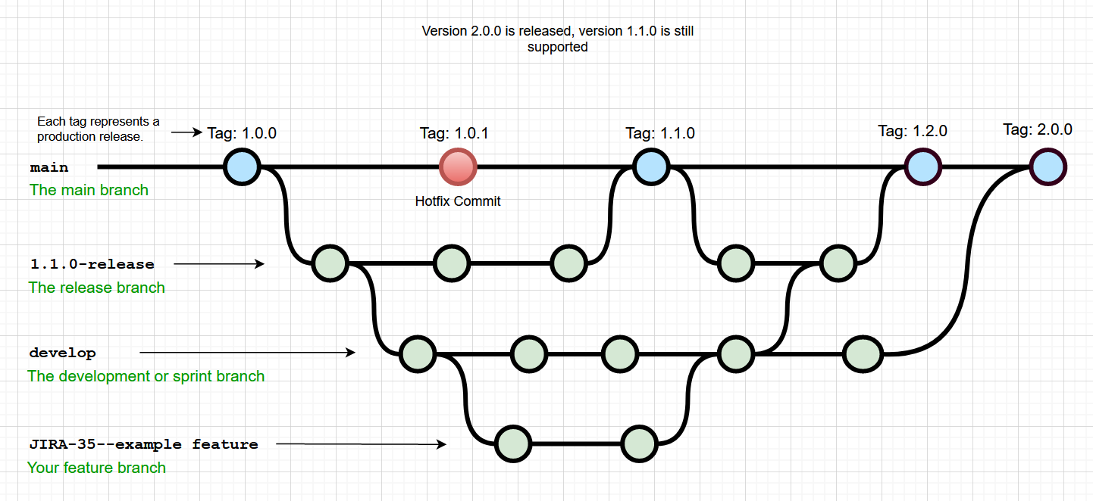
Bioinformatic analysis design
Versioning system
Git, GitHub
Nonlinear development
Collaboration
Maintain support to older versions

Slide 7
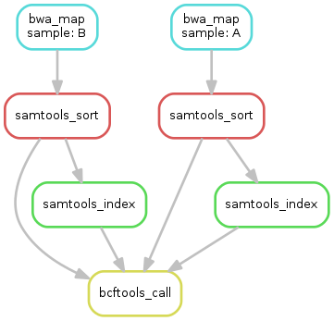
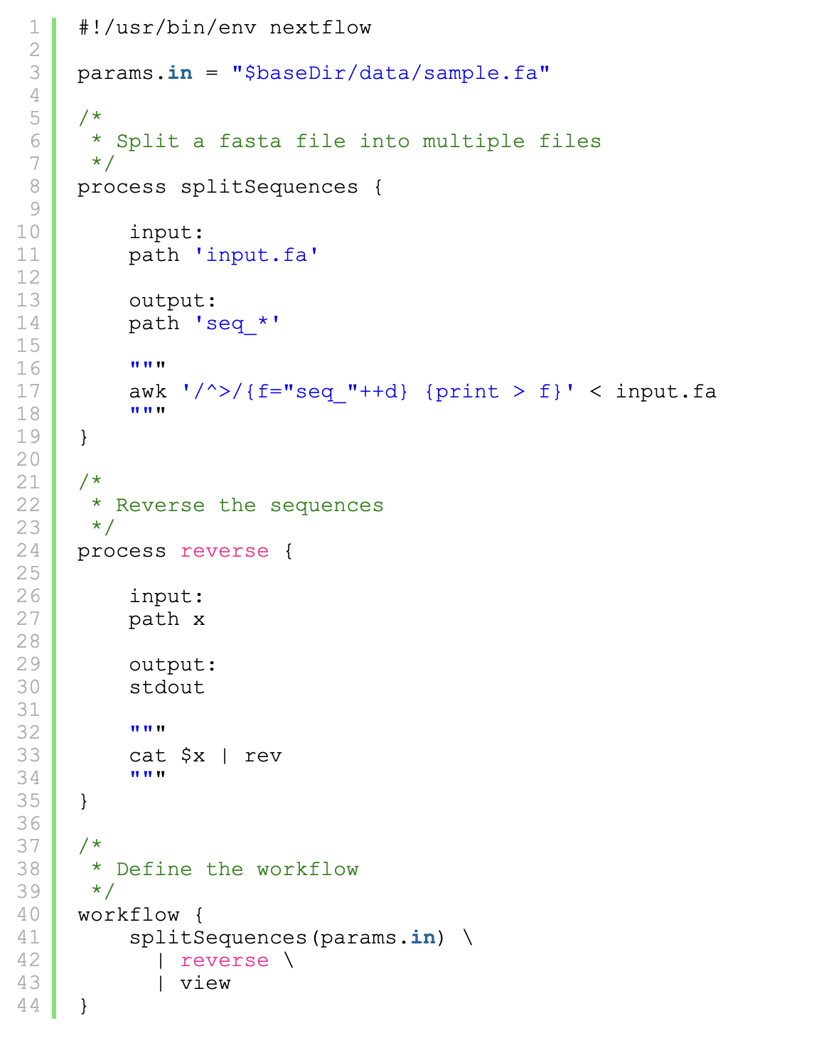
Bioinformatic analysis design
Workflow management
Nextflow, Snakemake
Represent data analysis as ‘workflows’
Analysis steps are wrapped into processes that can be connected
Modular, easier to share
Graphical example of workflow
Example of Nextflow
Notes:
These systems represent data analyses as “workflows,” in which the steps of the analysis are wrapped into processes that are connected to each other by data depen- dencies. Workflows have several benefits over traditional bash scripts. They allow analyses to be independent of the ex- ecution machine by removing the need for developers to im- plement code related to HPC schedulers. This makes the code more modular and easier to share and reuse. additionally, workflow systems improve efficiency by implementing task parallelization. Overall, they facilitate the organization and coordination of the various components necessary for imple- menting and executing data analyses.

Slide 8

Bioinformatic analysis design
Environment management
Docker, Singularity/Apptainer
Encapsulate, share, install, execute tools
Makes programs executable on large diversity of systems
Notes:
soft- ware designed to make programs, daemons, servers, etc. exe- cutable on a large diversity of systems, and therefore to make the software environment more independent, shareable, easily executable, and maintainable. These two containerization engines thus made possible to encapsulate, share, install and execute any bioinformatics tools in an easy and lightweight way. When used in conjunction with workflow management systems, these container technologies facilitate the sharing and execution of complex data analyses.
Software developers use containerization to deploy applications in multiple environments without rewriting the program code. They build an application once and deploy it on multiple operating systems. For example, they run the same containers on Linux and Windows operating systems.
“Just like a shipping container, a software container is a standardized package of software. Everything needed for the software to run is inside the container. The software code, runtime, system tools, system libraries, and settings are all inside a single container.”

Slide 9

Bioinformatic analysis design
Execution layer
Where the analysis will actually happen
Local, cloud, cluster
Depends on computational needs
High performance computing (HPC) for more computationally intensive tasks

Slide 11
Reprohackathon
MSc course offered at the Université Paris-Saclay (France)
Running for 3 years, attended by 123 students
Goals: (1) Introduce students to concepts and tools in bioinformatic reproducibility, and (2) gain practical experience in reproducing published findings while using reproducibility technologies
Part 1:
Learning about good practices in reproducibility
Learning about versioning (Git), workflows (Nextflow, Snakemake), containers (Docker, Singularity) and workflow execution
Part 2:
Practical application
Reproduce the findings of a published paper (RNA-seq to identify differentially expressed genes in uveal melanoma primary tumors)

Slide 12
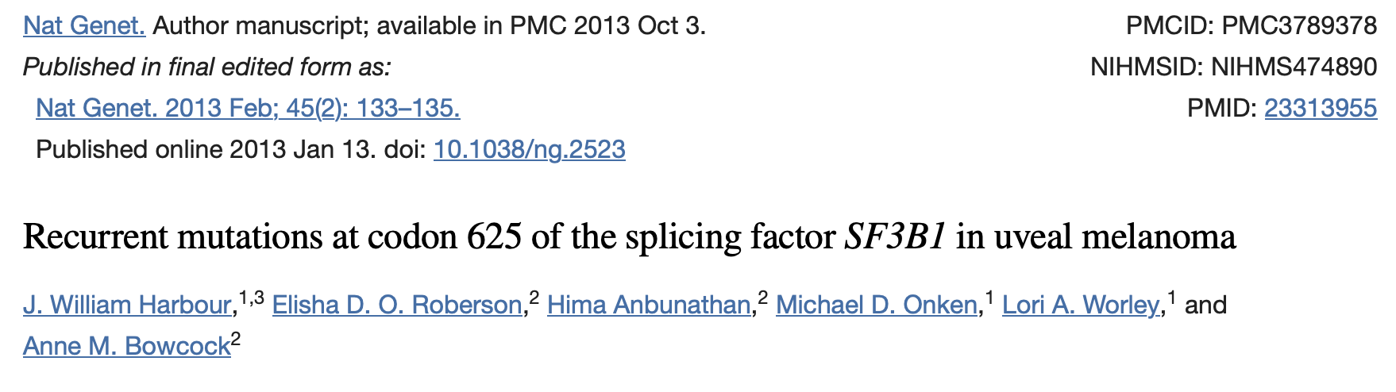
Reproducibility in practice
Harbour et al. (2013)
Sequencing of primary uveal melanomas
Discovered that SF3B1 gene has a deleterious mutation, where the mutation is associated with a better prognosis
To analyze the effect of mutation:
mutant SF3B1 tumors
wild-type SF3B1 tumors
Illumina BeadArray and RNA-sequencing
Identified 10 differentially expressed genes, no differential splicing

Slide 13
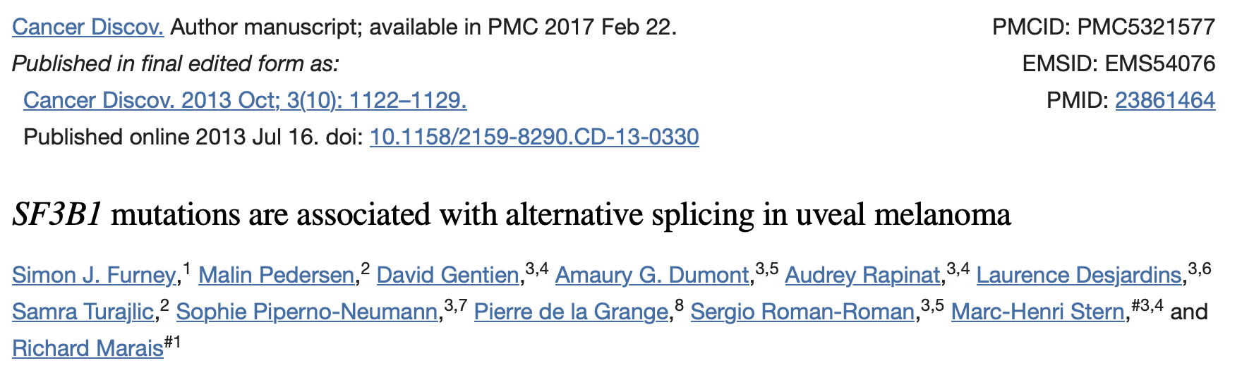
Reproducibility in practice
Harbour et al. (2013)
Sequencing of primary uveal melanomas
Discovered that SF3B1 gene has a deleterious mutation, where the mutation is associated with a better prognosis
To analyze the effect of mutation:
mutant SF3B1 tumors
wild-type SF3B1 tumors
Illumina BeadArray and RNA-sequencing
Identified 10 differentially expressed genes, no differential splicing
Furney et al. (2013)
Re-analyzed the RNA sequencing of Harper et al. (2013)
Identified differential alternative splicing

Slide 14
Reproducibility in practice
Harbour et al. (2013)
Sequencing of primary uveal melanomas
Discovered that SF3B1 gene has a deleterious mutation, where the mutation is associated with a better prognosis
To analyze the effect of mutation:
mutant SF3B1 tumors
wild-type SF3B1 tumors
Illumina BeadArray and RNA-sequencing
Identified 10 differentially expressed genes, no differential splicing
Furney et al. (2013)
Re-analyzed the RNA sequencing of Harper et al. (2013)
Identified differential alternative splicing
Goal for Reprohackathon:
Reanalyze the RNA sequencing and identify differentially expressed genes

Slide 15
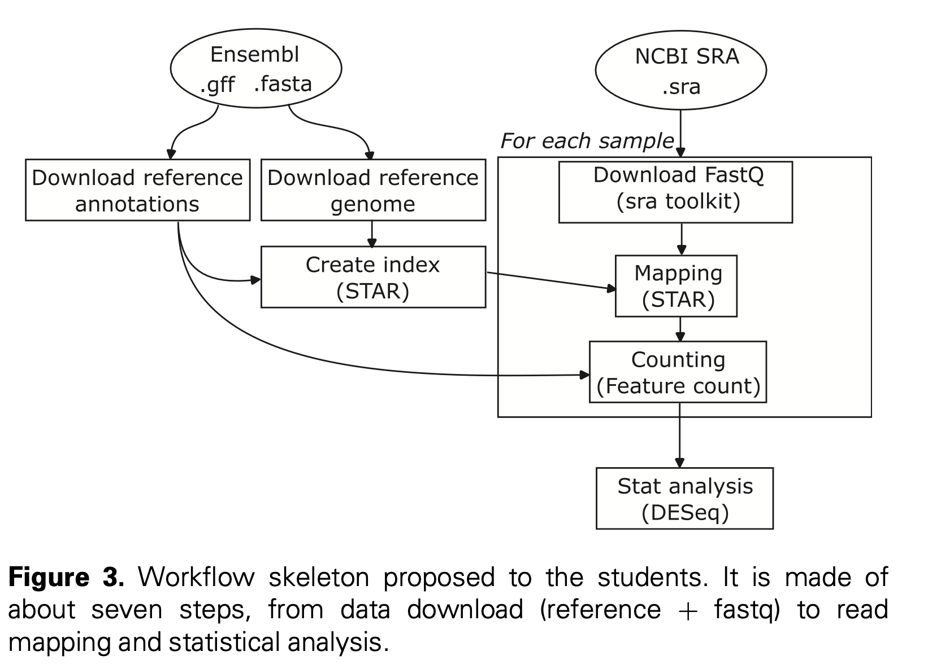

Slide 16
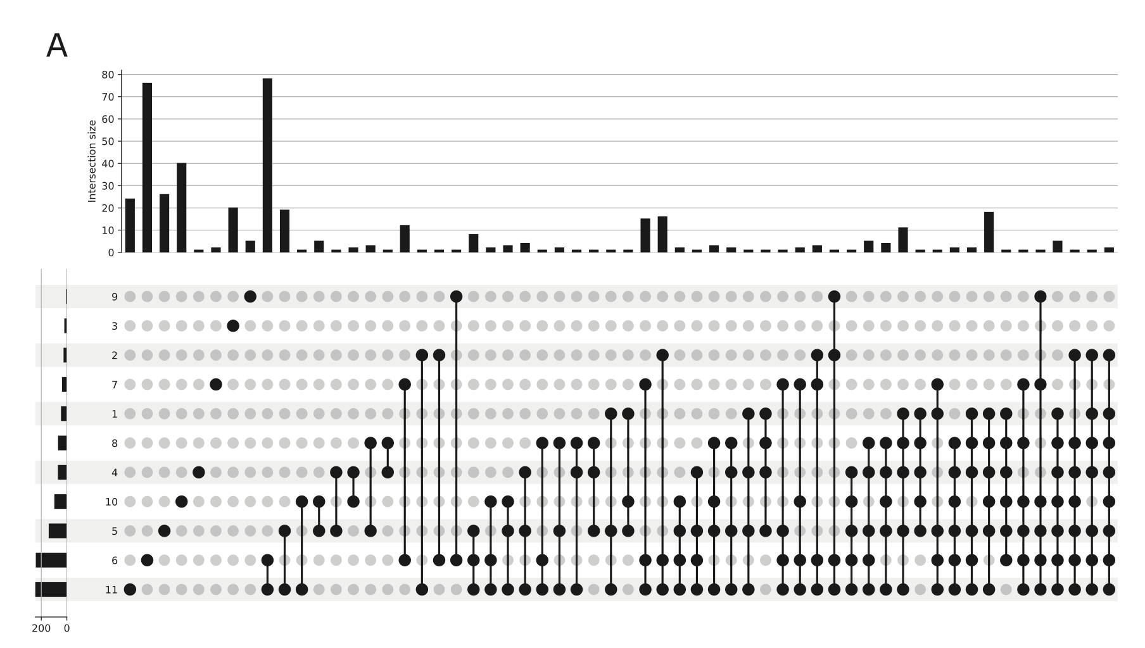
There is a large variability across the student groups between the identified differentially expressed genes

Slide 17
Differential gene expression analysis
Step 1:
Raw data → mapped read counts
Example of errors
Genome, annotation version (different versions or incompatible versions)
Exclusion/inclusion of mitochondrial genome
Mislabelled rows/columns
Parameters in alignment tools
Step 2:
Read counts → differential expression results
Example of errors
Threshold choices (p-value, fold change)
Filtering lowly expressed genes
Filtering low quality samples
Parameters in statistical analysis (experimental design set-up, paired tests, multiple hypothesis testing correction)

Slide 18
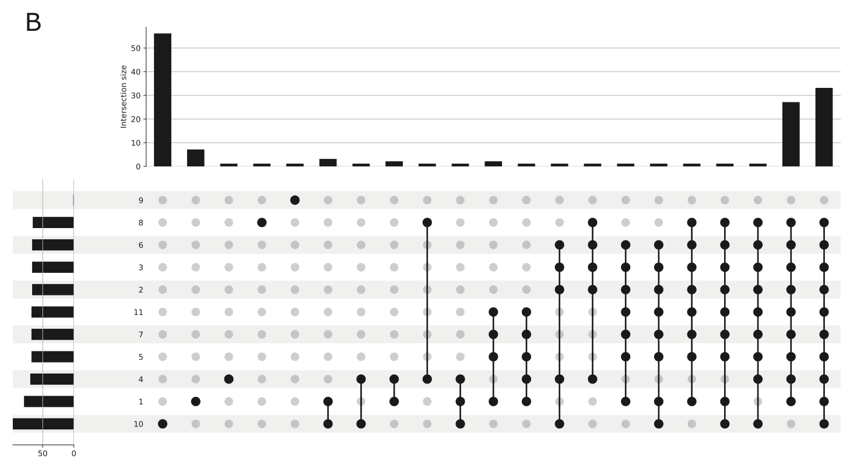
The variability of identified differentially expressed genes is greatly reduced when the statistical analysis is homogenized

Slide 19
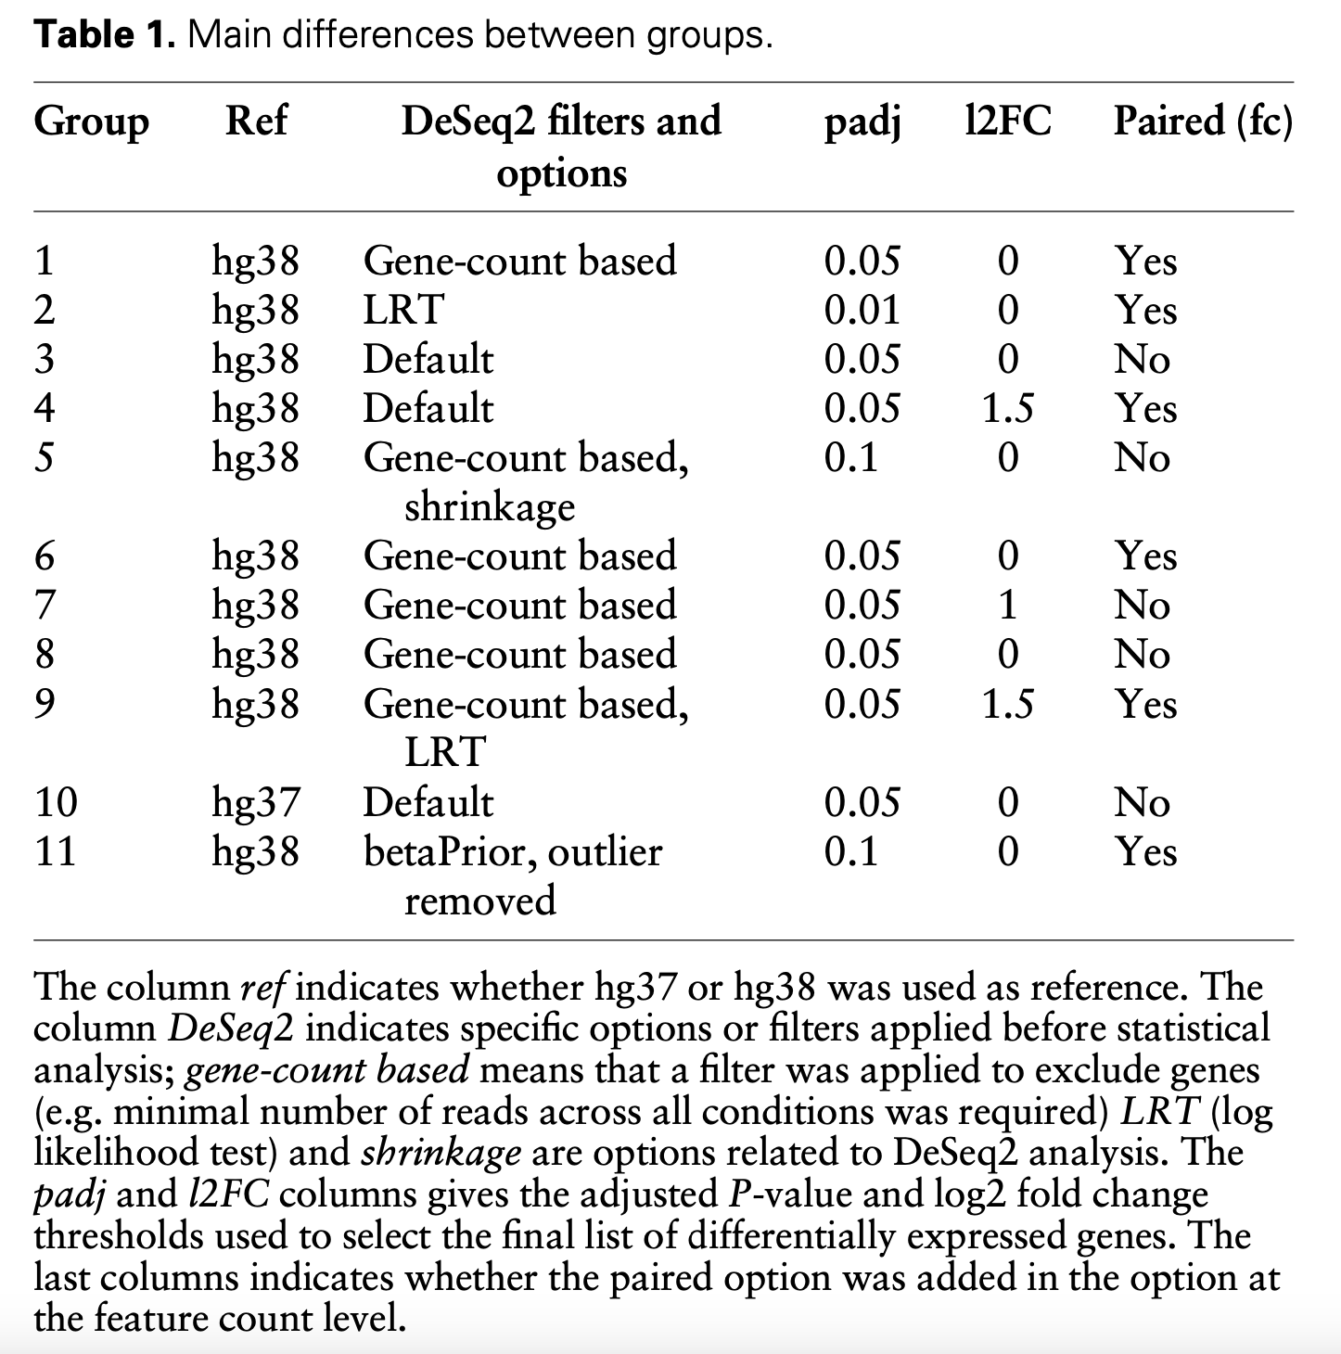

Slide 20
Final thoughts
Good practices in bioinformatic reproducibility
Use versioning, workflow and environment management systems
Plan analyses in modular, independent sections that can more easily be organized and shared
Parameter details are crucial - record them and make them clear!

Slide 22
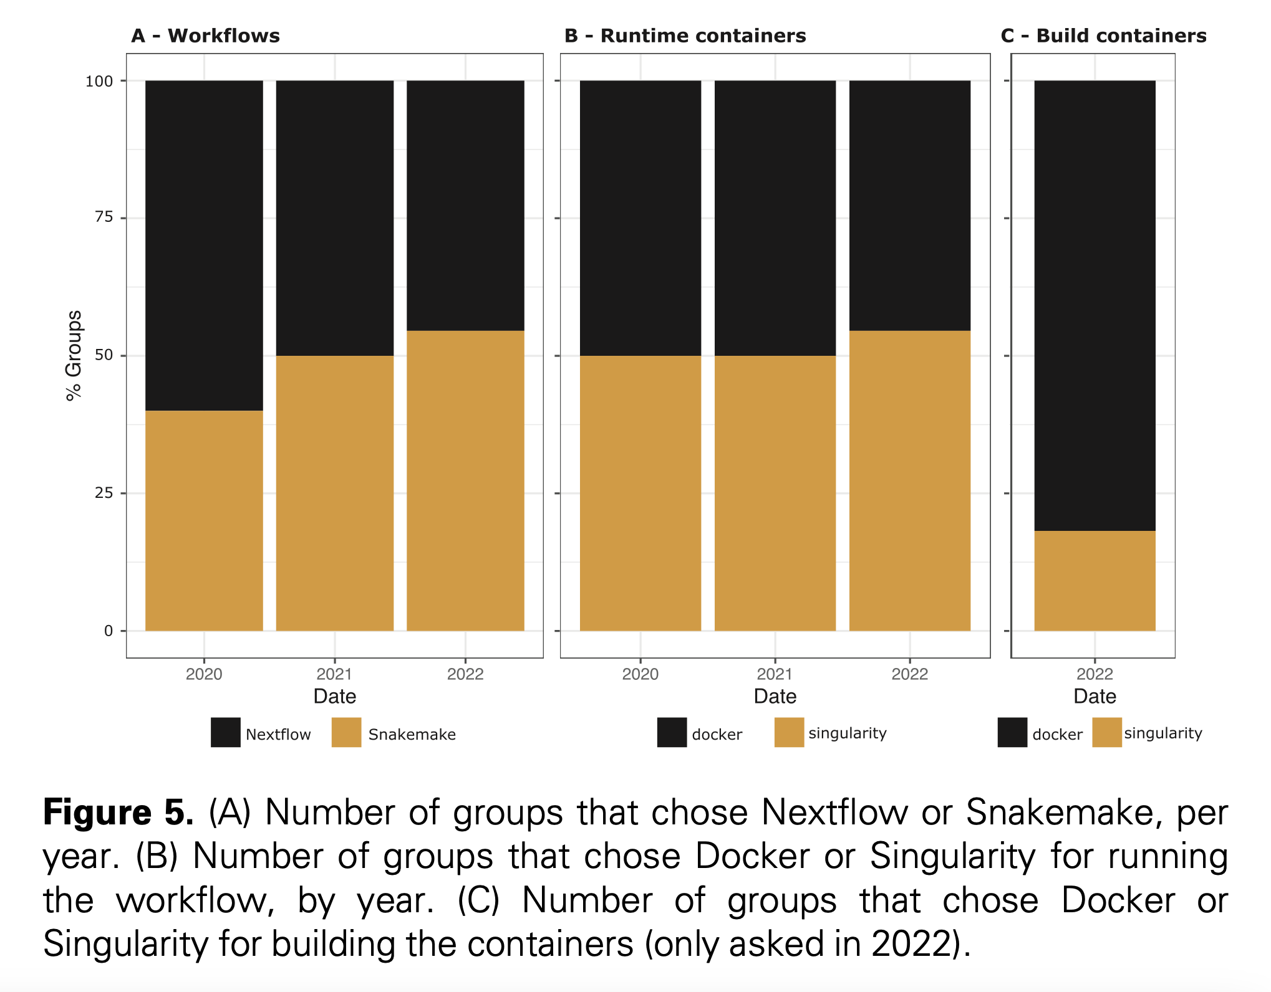

Slide 23
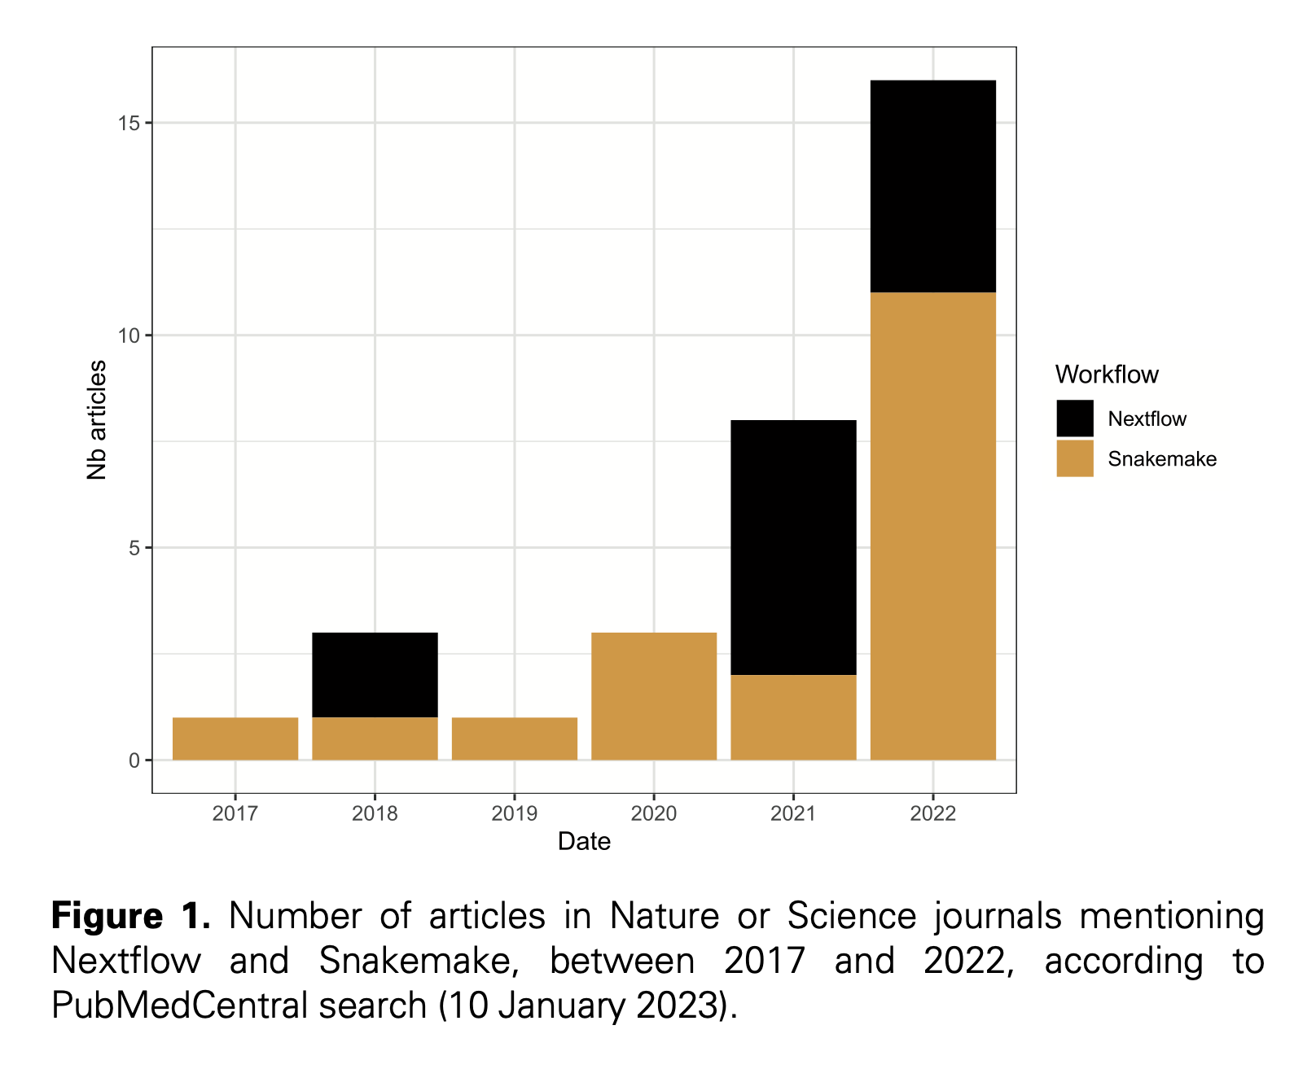

Slide 24
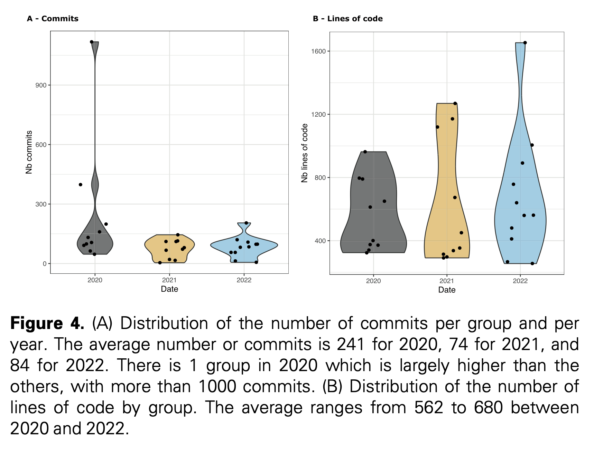

Slide 25
